Slide 1
Support Vector Machines
Hongyu Guo
2024 Winter

Slide 2
History of SVM
SVM is related to statistical learning theory [3]
SVM was first introduced in 1992 [1]
SVM becomes popular because of its success in handwritten digit recognition
  1.1% test error rate for SVM. This is the same as the error rates of a carefully constructed neural network, LeNet 4.
    See Section 5.11 in [2] or the discussion in [3] for details
SVM is now regarded as an important example of “kernel methods”, one of the key area in machine learning
[1] B.E. Boser et al. A Training Algorithm for Optimal Margin Classifiers. Proceedings of the Fifth Annual Workshop on Computational Learning Theory 5 144-152, Pittsburgh, 1992.
[2] L. Bottou et al. Comparison of classifier methods: a case study in handwritten digit recognition. Proceedings of the 12th IAPR International Conference on Pattern Recognition, vol. 2, pp. 77-82.
[3] V. Vapnik. The Nature of Statistical Learning Theory. 2nd edition, Springer, 1999.
Notes:
First introduced in COLT-92 by Boser, Guyon and Vapnik
COLT = computational learning theory
B. Scholkopf et al. ICANN 96. 47-52.

Slide 3
What is a good Decision Boundary?
Consider a two-class, linearly separable classification problem
Many decision boundaries!
  The Perceptron algorithm can be used to find such a boundary
  Different algorithms have been proposed
Are all decision boundaries equally good?
Class 2
Class 1
Notes:
Perceptron learning rule can be used to find any decision boundary between class 1 and class 2

Slide 4
Linear Classifiers
α
x
f
y^{est}
f(x,w,b) = sign(w. x + b)
denotes +1
denotes -1
Any of these would be fine..
..but which is best?

Slide 5
Examples of Bad Decision Boundaries
Class 2
Class 2
Class 1
Class 1

Slide 6
Classifier Margin
α
x
f
y^{est}
f(x,w,b) = sign(w. x + b)
denotes +1
denotes -1
Define the margin of a linear classifier as the width that the boundary could be increased by before hitting a datapoint.

Slide 7
Maximum Margin
α
x
f
y^{est}
f(x,w,b) = sign(w. x + b)
denotes +1
denotes -1
The maximum margin linear classifier is the linear classifier with the maximum margin.
This is the simplest kind of SVM (Called an LSVM)
Linear SVM

Slide 8
Maximum Margin
α
x
f
y^{est}
f(x,w,b) = sign(w. x - b)
denotes +1
denotes -1
The maximum margin linear classifier is the linear classifier with the maximum margin.
This is the simplest kind of SVM (Called an LSVM)
Support Vectors are those datapoints that the margin pushes up against
Linear SVM

Slide 9

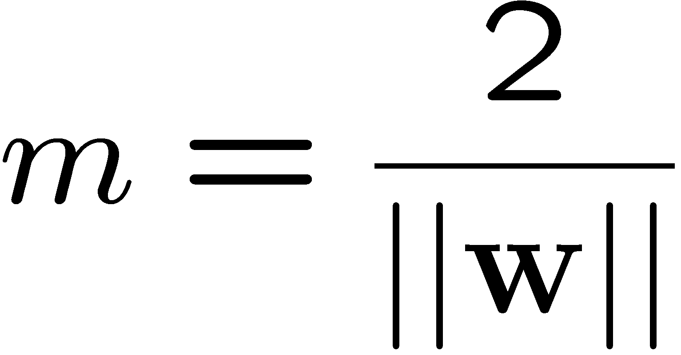
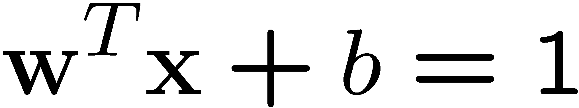
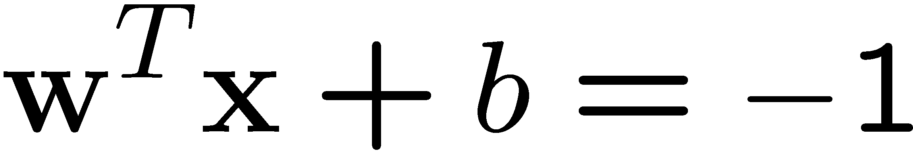
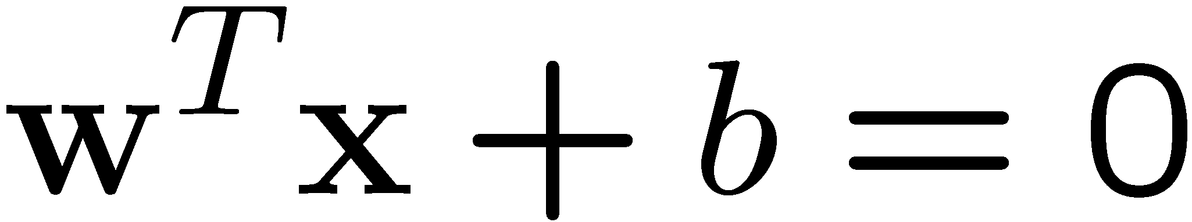
Large-margin Decision Boundary
The decision boundary should be as far away from the data of both classes as possible
  We should maximize the margin, m
  Distance between the origin and the line w^{t}x=k is k/||w||
Class 2
m
Class 1
Notes:
The perpendicular distance of a point x from a hyperplane defined by y(x)=0 where y(x) is given by |y(x)|/||w||.

Slide 10
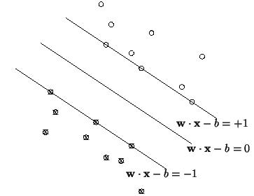
Maximizing the margin
We want a classifier with as big margin as possible.
H1
H
H2
Recall the distance from a point(x₀,y₀) to a line:
Ax+By+c = 0 is|A x₀ +B y₀ +c|/sqrt(A²+B²)
d+
d-
The distance between H and H1 is:
|w•x+b|/||w||=1/||w||
The distance between H1 and H2 is: 2/||w||
In order to maximize the margin, we need to minimize ||w||. With the
condition that there are no datapoints between H1 and H2:
x_{i}•w+b ≥ +1 when y_{i} =+1
x_{i}•w+b ≤ -1 when y_{i} =-1 Can be combined into yi(x_{i}•w) ≥ 1

Slide 11
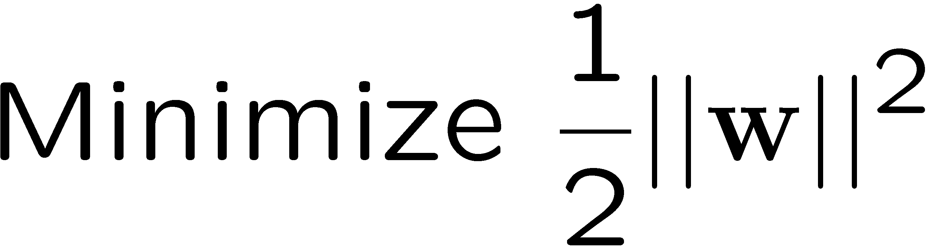
Finding the Decision Boundary
Let {x₁, ..., x_{n}} be our data set and let y_{i} ∈ {1,-1} be the class label of x_{i}
The decision boundary should classify all points correctly ⇒
The decision boundary can be found by solving the following constrained optimization problem
This is a constrained optimization problem. Solving it requires some new tools
Notes:
The factor of ½ is included for later convenience.

Slide 12
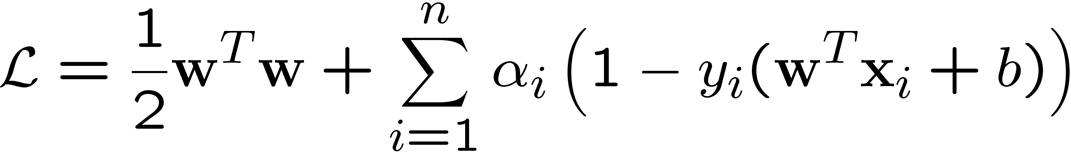

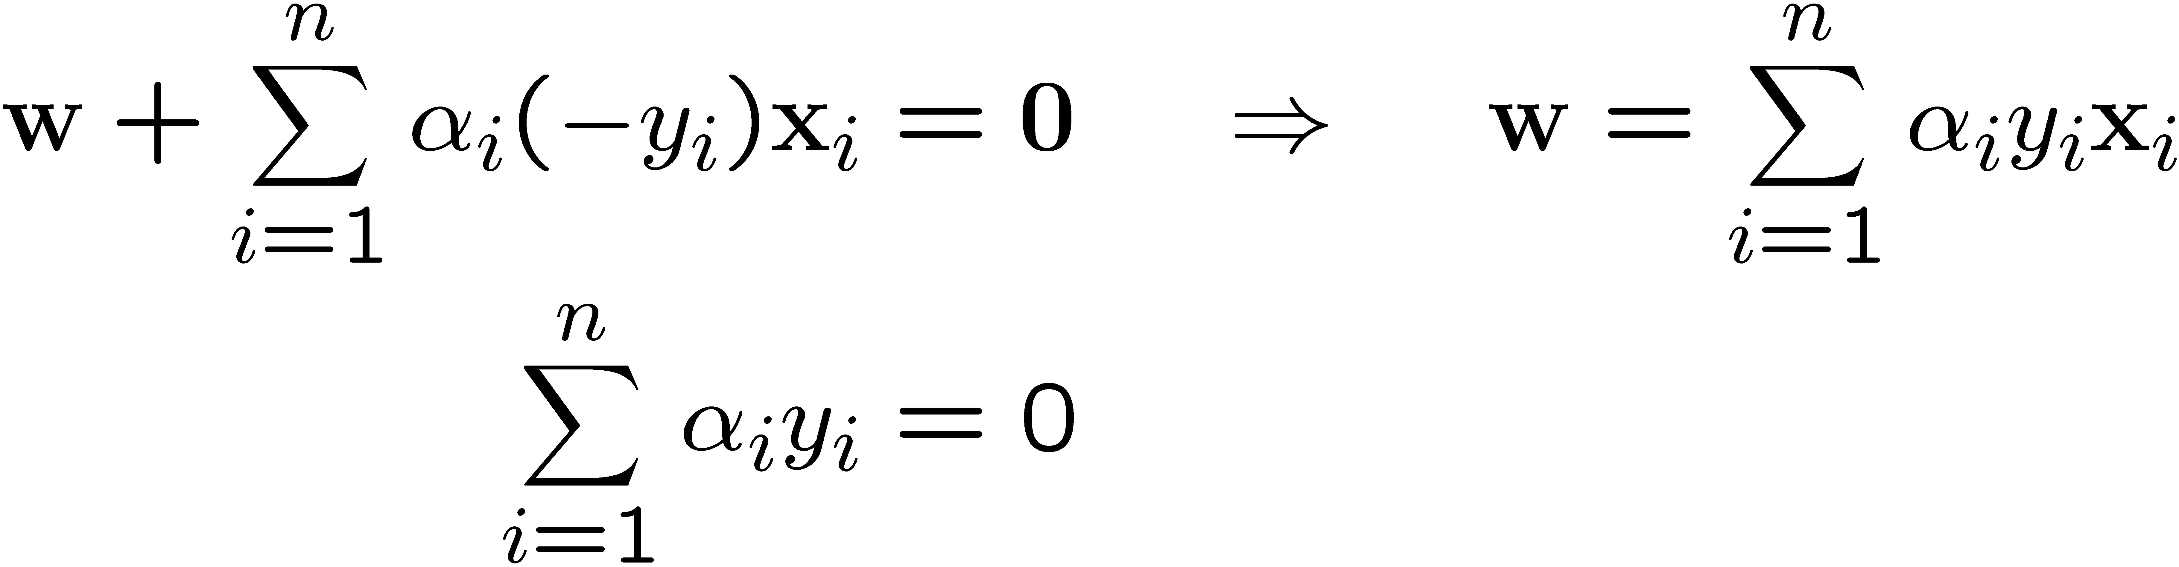
Finding the Decision Boundary
The Lagrangian is
  Note that ||w||² = w^{T}w
  Introduce a Lagrange multiplier α_{i} for each of the constraints
Setting the gradient of w.r.t. w and b to zero, we have

Slide 13
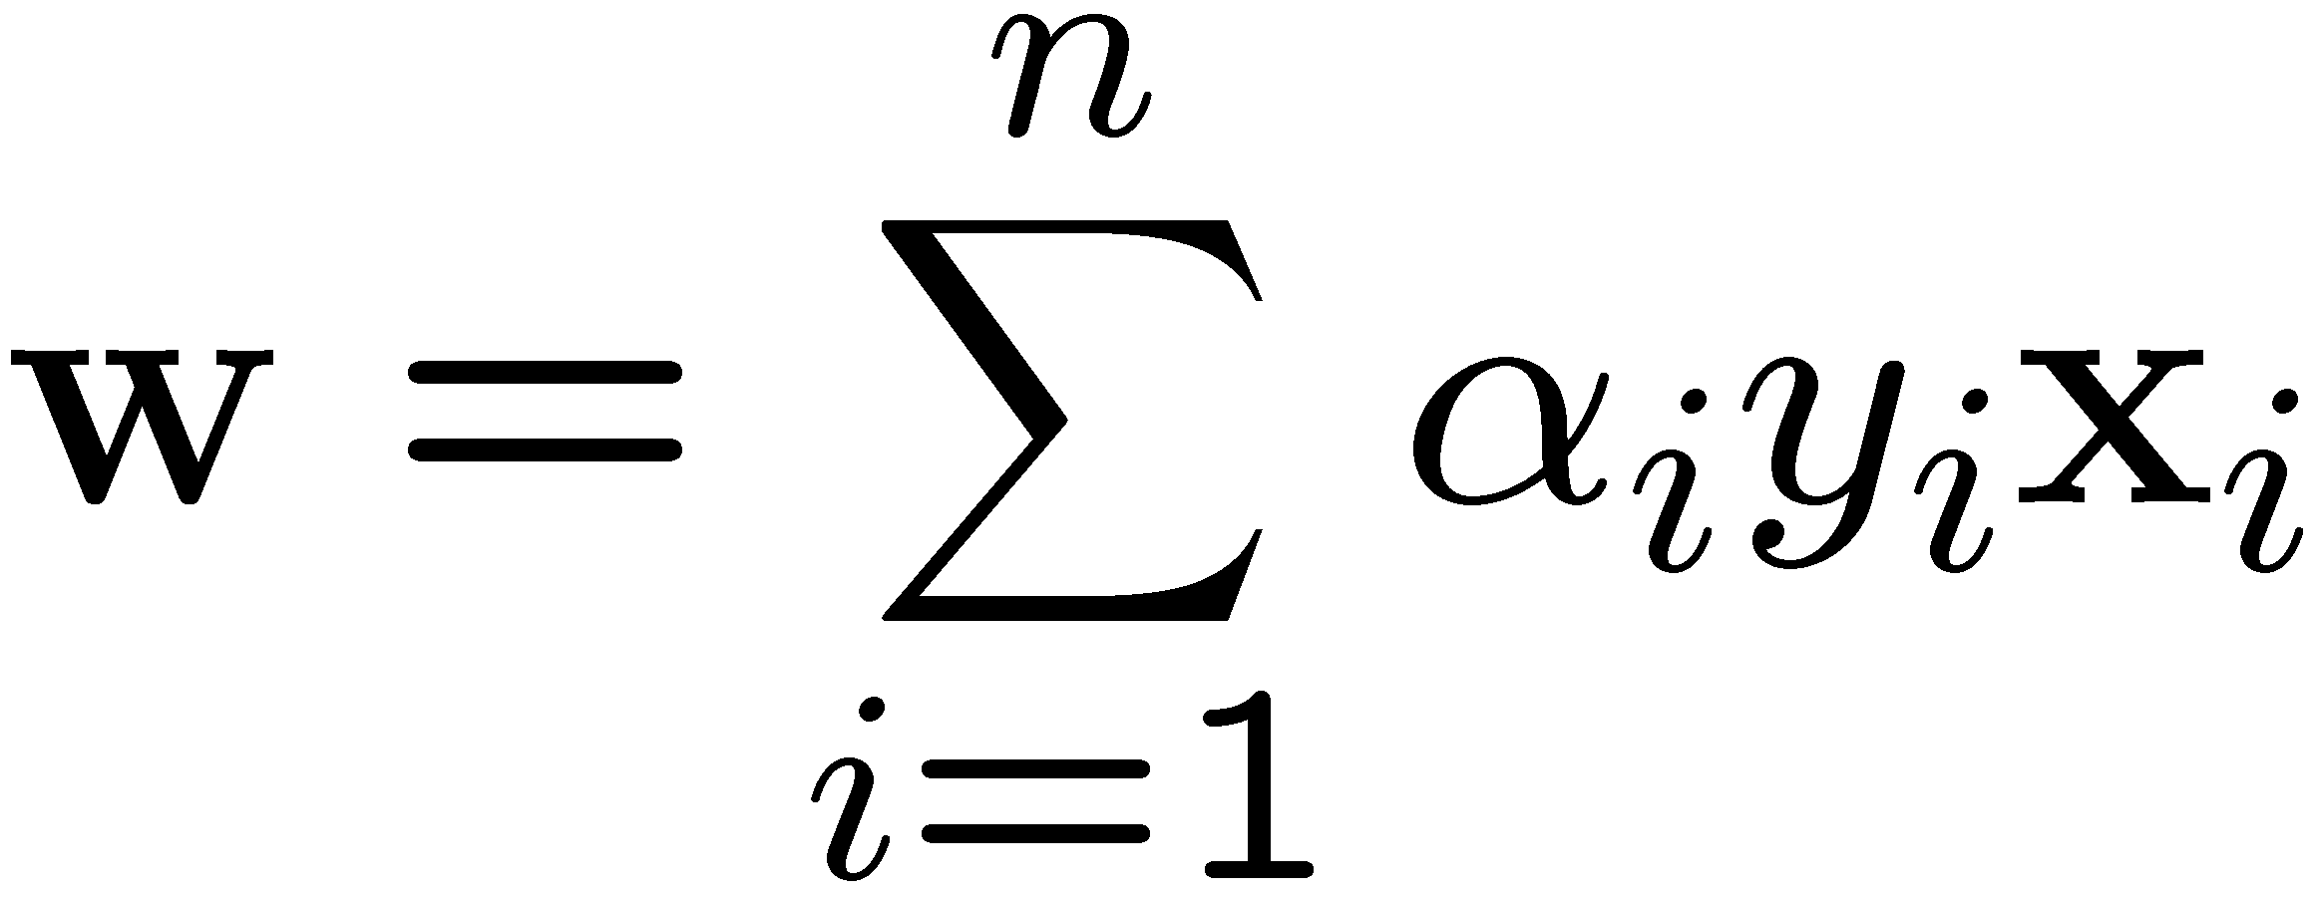
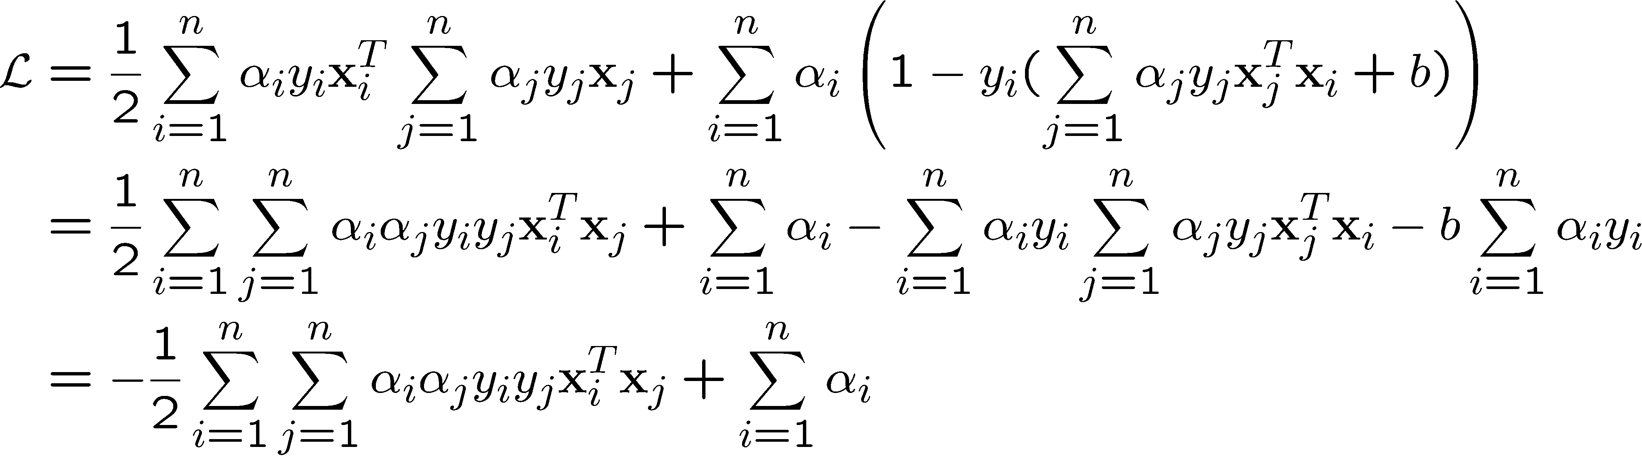
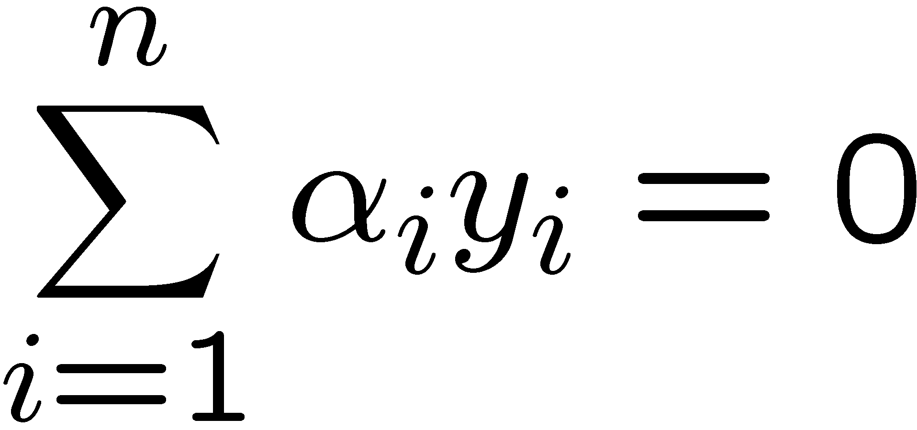
The Dual Problem
If we substitute to , we have
Note that
This is a function of α_{i} only
α_{i} >=0
Ready for the kernel trick!

Slide 14
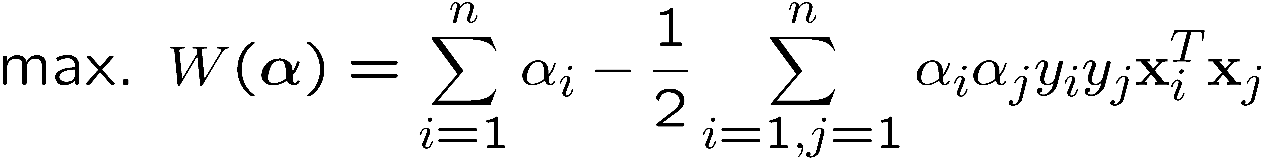
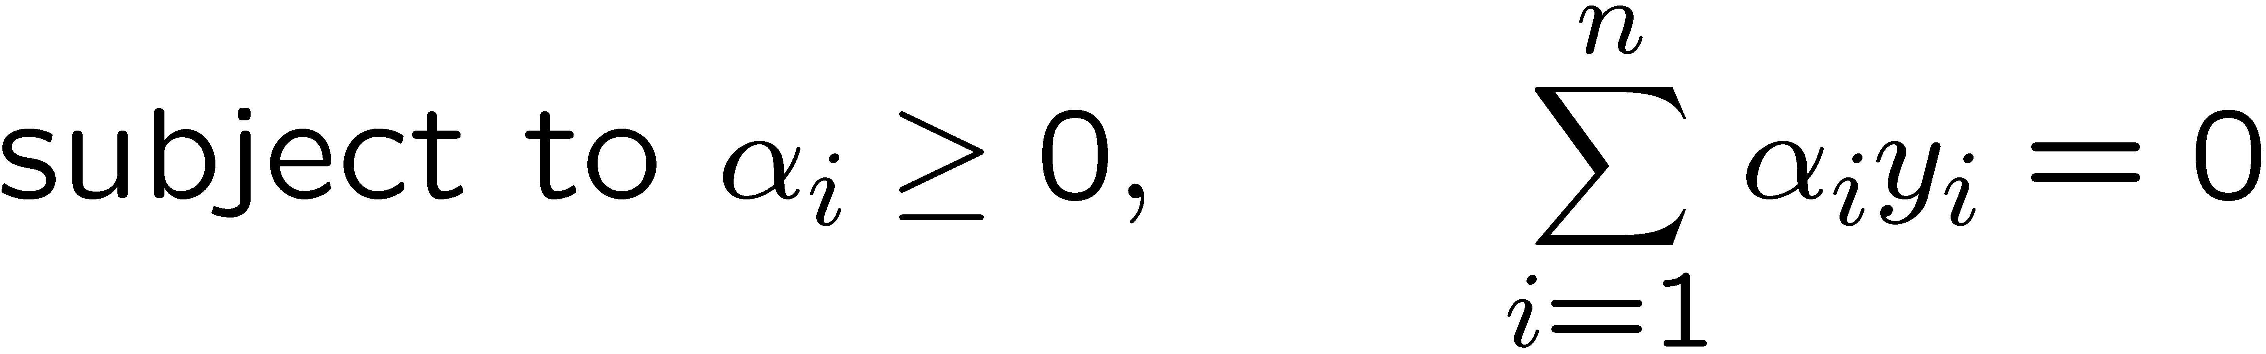
The Dual Problem
The new objective function is in terms of α_{i} only
It is known as the dual problem: if we know w, we know all α_{i}; if we know all α_{i}, we know w
The original problem is known as the primal problem
The objective function of the dual problem needs to be maximized!
The dual problem is therefore:
Properties of α_{i} when we introduce the Lagrange multipliers
The result when we differentiate the original Lagrangian w.r.t. b

Slide 15
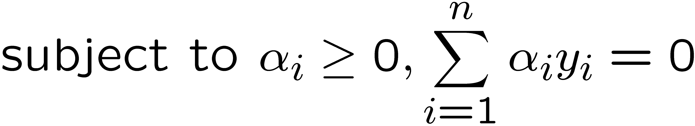

The Dual Problem
This is a quadratic programming (QP) problem
  A global maximum of α_{i} can always be found
w can be recovered by
Notes:
Let x(1) and x(-1) be two S.V.
Then b = -1/2( w^T x(1) + w^T x(-1) )

Slide 16
Consequently…
The only points with positive Lagrange coefficients are support vectors
The other points play no role (they don’t add anything to the evaluation)
You only need to retain support vectors, once the model is trained! (Huge savings!)

Slide 17
A Geometrical Interpretation
Class 2
α₁₀=0
α₈=0.6
α₇=0
α₂=0
α₅=0
α₁=0.8
α₄=0
α₆=1.4
α₉=0
α₃=0
Class 1
Notes:
So, if change internal points, no effect on the decision boundary

Slide 18
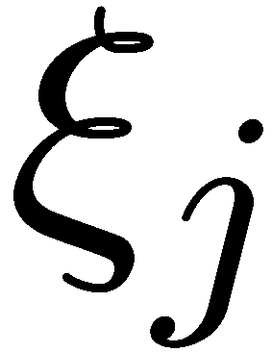
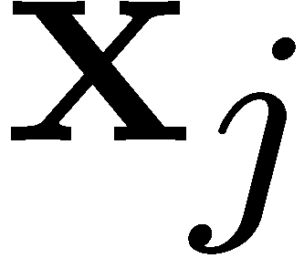
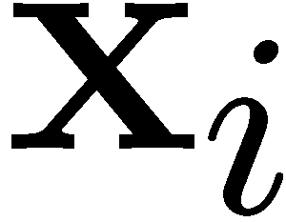
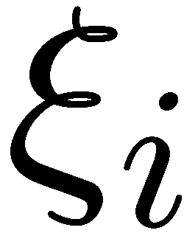
Overlapping: Non-linearly Separable Problems
We allow “error” ξ_{i} in classification; it is based on the output of the discriminant function w^{T}x+b
ξ_{i} approximates the number of misclassified samples
ξ_{i} > 1 will be misclassified
Class 2
Class 1

Slide 19
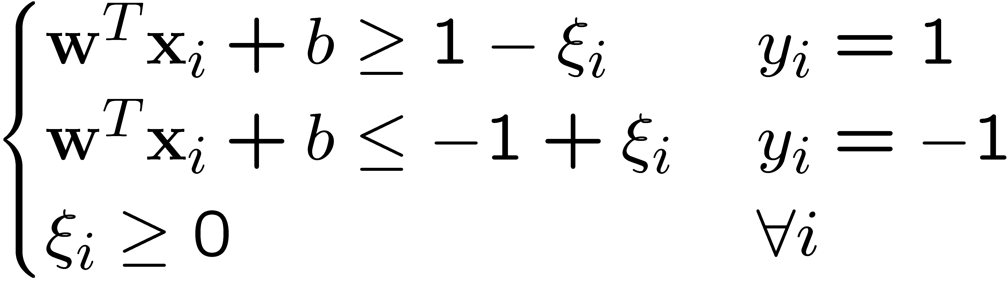
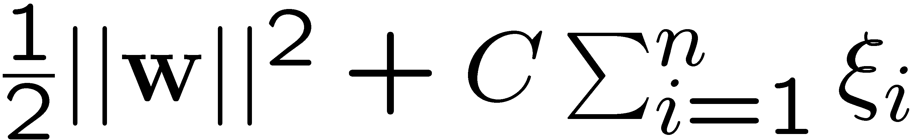
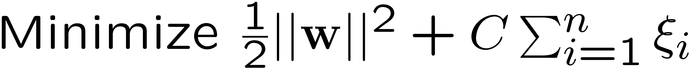
Soft Margin Hyperplane
If we minimize ∑_{i}ξ_{i}, ξ_{i} can be computed by
  ξ_{i} are “slack variables” in optimization
  Note that ξ_{i}=0 if there is no error for x_{i}
  ξ_{i} is an upper bound of the number of errors
We want to minimize
  C : tradeoff parameter between error and margin
The optimization problem becomes
Notes:
Our goal is to maximize the margin while softly penalizing points that lie on the wrong side of the margin boundary.

Slide 20
Problems with linear SVM
=-1
=+1
What if the decision function is not a linear?

Slide 21
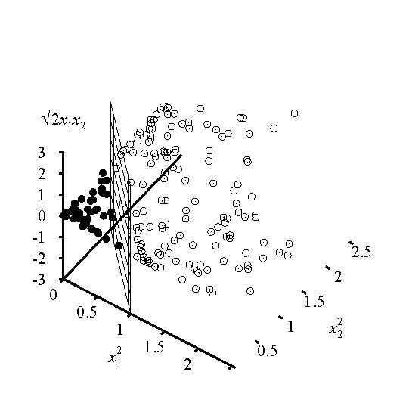
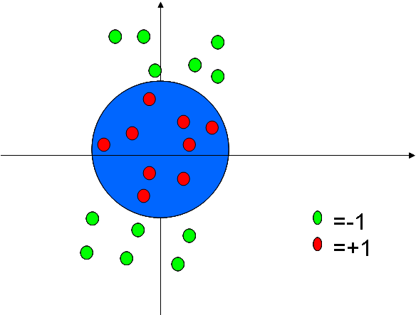
Extension to Non-linear Decision Boundary

Slide 22
Extension to Non-linear Decision Boundary
So far, we have only considered large-margin classifier with a linear decision boundary
How to generalize it to become nonlinear?
Key idea: transform x_{i} to a higher dimensional space to “make life easier”
  Input space: the space the point x_{i} are located
  Feature space: the space of φ(x_{i}) after transformation
Why transform?
  Linear operation in the feature space is equivalent to non-linear operation in input space
  Classification can become easier with a proper transformation. In the XOR problem, for example, adding a new feature of x₁x₂ make the problem linearly separable
Notes:
XOR: x_1, x_2, and we want to transform to x_1^2, x_2^2, x_1 x_2
It can also be viewed as feature extraction from the feature vector x, but now we extract more feature than the number of features in x.

Slide 23
Transforming the Data
φ( )
φ( )
φ( )
φ( )
φ( )
φ(.)
φ( )
φ( )
φ( )
φ( )
φ( )
φ( )
φ( )
φ( )
φ( )
φ( )
φ( )
φ( )
φ( )
Input space
Feature space
Note: feature space is of higher dimension than the input space in practice
Computation in the feature space can be costly because it is high dimensional
  The feature space can be infinite-dimensional!
The kernel trick comes to rescue

Slide 24
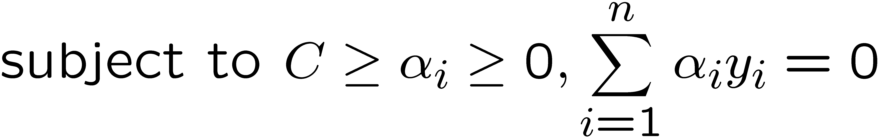
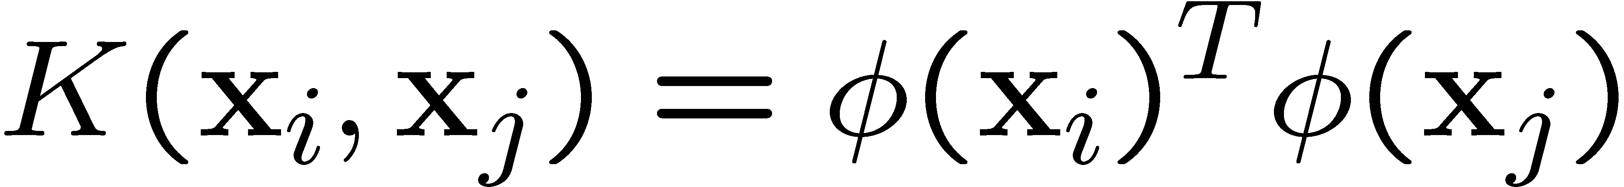
The Kernel Trick
Recall the SVM optimization problem
The data points only appear as inner product
As long as we can calculate the inner product in the feature space, we do not need the mapping explicitly
Many common geometric operations (angles, distances) can be expressed by inner products
Define the kernel function K by

Slide 25
An Example for φ(.) and K(.,.)
Suppose φ(.) is given as follows
An inner product in the feature space is
So, if we define the kernel function as follows, there is no need to carry out φ(.) explicitly
This use of kernel function to avoid carrying out φ(.) explicitly is known as the kernel trick

Slide 26
Kernel Functions
In practical use of SVM, the user specifies the kernel function; the transformation φ(.) is not explicitly stated
Given a kernel function K(x_{i}, x_{j}), the transformation φ(.) is given by its eigenfunctions (a concept in functional analysis)
  Eigenfunctions can be difficult to construct explicitly
  This is why people only specify the kernel function without worrying about the exact transformation
Another view: kernel function, being an inner product, is really a similarity measure between the objects

Slide 27
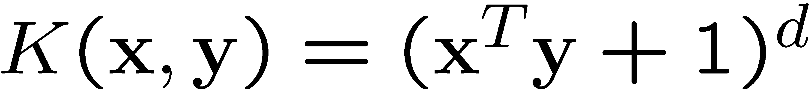
Examples of Kernel Functions
Polynomial kernel with degree d
Radial basis function kernel with width σ
  Closely related to radial basis function neural networks
  The feature space is infinite-dimensional
Sigmoid with parameter κ and θ
  It does not satisfy the Mercer condition on all κ and θ
Notes:
Despite violating Mercer condition, the sigmoid kernel function can still work

Slide 28
The parameter C for non-linear SVMs
Perfect separation of training data can, in general be achieved in the enlarged feature space F
Such perfect separation is actually bad: it leads to the danger of overfitting the data. Then the classifier will generalize poorly.
A proper setting of C allows to avoid overfitting

Slide 29
C in non-linear SVMs
Let’s look once again at the objective function
C is the penalty for errors of misclassification
  Large C: discourages any positive parameters ⇒ tendency to overfit the data ⇒highly complicated boundaries in input space
  Small C: encourages a small value of ||w|| ⇒ larger margin ⇒more data on the wrong side of the margin ⇒ smoother decision boundary in input space
  In practice: tune C to achieve best performance

Slide 30
Why SVM Work?
The feature space is often very high dimensional. Why don’t we have the curse of dimensionality?
A classifier in a high-dimensional space has many parameters and is hard to estimate
Vapnik argues that the fundamental problem is not the number of parameters to be estimated. Rather, the problem is about the flexibility of a classifier
Typically, a classifier with many parameters is very flexible.

Slide 31
Choosing the Kernel Function
Probably the most tricky part of using SVM.
The kernel function is important because it creates the kernel matrix, which summarizes all the data.
In practice, a low degree polynomial kernel or RBF kernel with a reasonable width is a good initial try.
Note that SVM with RBF kernel is closely related to RBF neural networks, with the centers of the radial basis functions automatically chosen for SVM

Slide 32
Some commonly used kernels
Polynomial:
Gaussian radial basis function
Parameters that the user must choose
Neural net:
For the neural network kernel, there is one “hidden unit” per support vector, so the process of fitting the maximum margin hyperplane decides how many hidden units to use. Also, it may violate Mercer’s condition.

Slide 33
Strengths and Weaknesses of SVM
Strengths
  Training is relatively easy
    No local optimal, unlike in neural networks
  It scales relatively well to high dimensional data
  Tradeoff between classifier complexity and error can be controlled explicitly
  Non-traditional data like strings and trees can be used as input to SVM, instead of feature vectors
Weaknesses
  Need to choose a “good” kernel function.

Slide 34
Resources
http://www.kernel-machines.org/
http://www.support-vector.net/
http://www.support-vector.net/icml-tutorial.pdf
http://www.kernel-machines.org/papers/tutorial-nips.ps.gz
http://www.clopinet.com/isabelle/Projects/SVM/applist.html

